Slide 1
Chapter 6 Distributed File Systems and Name Services

Slide 2
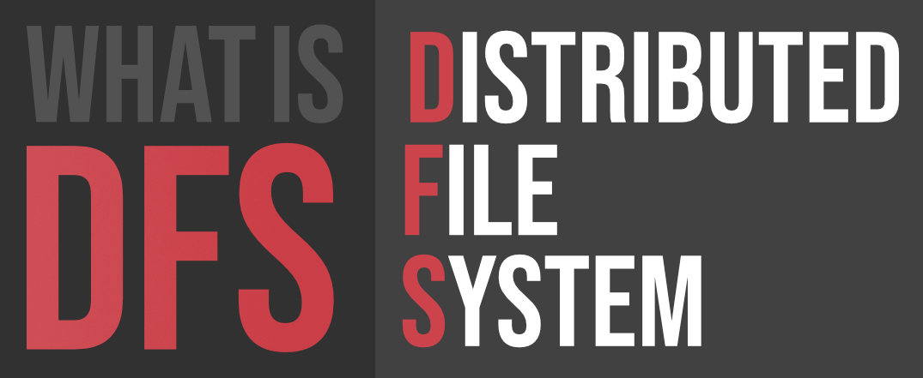

Slide 3
A Distributed File System (DFS) as the name suggests, is a file system that is distributed on multiple file servers or multiple locations.
It allows programs to access or store isolated files as they do with the local ones, allowing programmers to access files from any network or computer.
The main purpose of the Distributed File System (DFS) is to allows users of physically distributed systems to share their data and resources by using a Common File System.

Slide 4
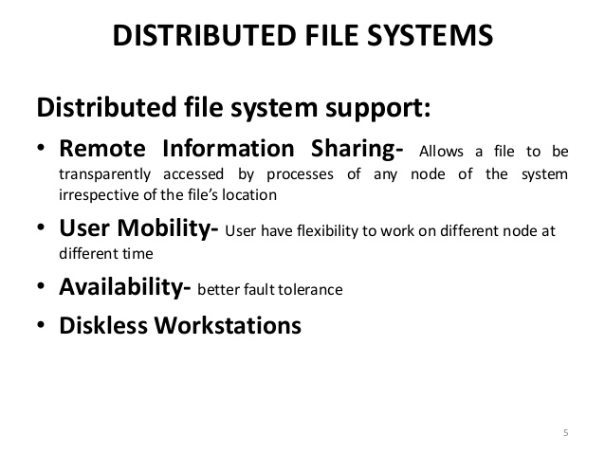

Slide 5
Features of DFS
1. Transparency:
Structure transparency: There is no need for the client to know about the number or locations of file servers and the storage devices. Multiple file servers should be provided for performance, adaptability, and dependability.
Access transparency: Both local and remote files should be accessible in the same manner. The file system should be automatically located on the accessed file and send it to the client’s side.
Naming transparency: There should not be any hint in the name of the file to the location of the file. Once a name is given to the file, it should not be changed during transferring from one node to another.
Replication transparency: If a file is copied on multiple nodes, both the copies of the file and their locations should be hidden from one node to another.

Slide 6
2. User mobility: It will automatically bring the user’s home directory to the node where the user logs in.
3. Performance: Performance is based on the average amount of time needed to convince the client requests. This time covers the CPU time + time taken to access secondary storage + network access time. It is advisable that the performance of the Distributed File System be similar to that of a centralized file system.
4. Simplicity and ease of use: The user interface of a file system should be simple and the number of commands in the file should be small.

Slide 7
5. High availability: A Distributed File System should be able to continue in case of any partial failures like a link failure, a node failure, or a storage drive crash.
6. High reliability: Probability of loss of stored data should be minimized. System should automatically generate backup copies of critical files.
7. Scalability: Growth of nodes and users should not seriously disrupt service

Slide 8
8. Data integrity: Concurrent access requests from multiple users who are competing to access the file must be properly synchronized by the use of some form of concurrency control mechanism.
9. Security: Users should be confident of the privacy of their data.
10. Heterogeneity: There should be easy access to shared data on diverse platforms.

Slide 9
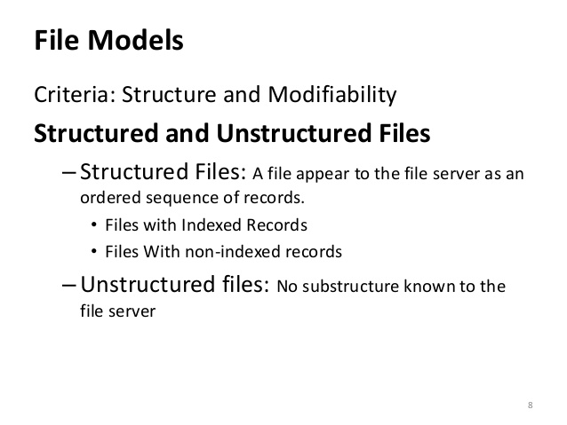

Slide 10
Structured data
Structured data is data that has been predefined and formatted to a set structure before being placed in data storage, which is often referred to as schema-on-write.
Pros:
Easily used by machine learning algorithms
Increased access to more tools
Cons:
Increased access to more tools
Limited storage options

Slide 11
Unstructured data
Unstructured data is data stored in its native format and not processed until it is used, which is known as schema-on-read.
Pros:
Freedom of the native format
Faster accumulation rates
Cons:
Requires data science expertise
Specialized tools

Slide 12
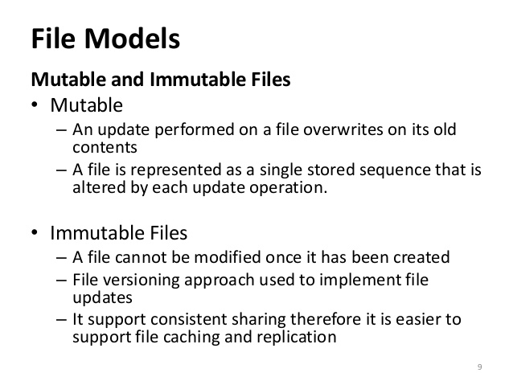

Slide 13
File Accessing Models
File Accessing Models depends on the following two factors:
1. Method of Accessing remote files
2. Unit of Data Transfer

Slide 14
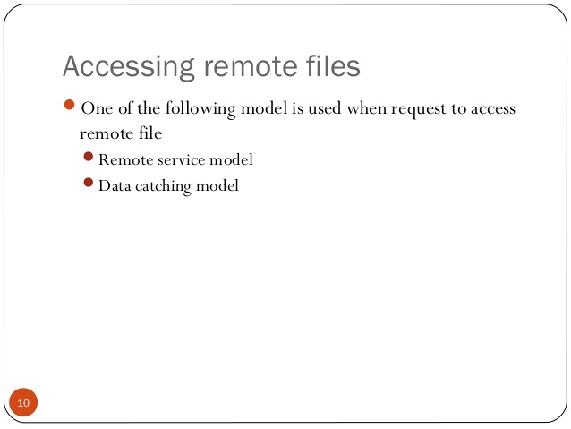

Slide 15
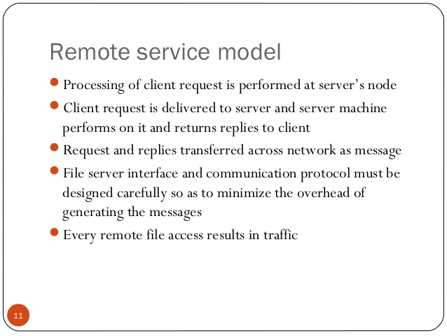

Slide 16
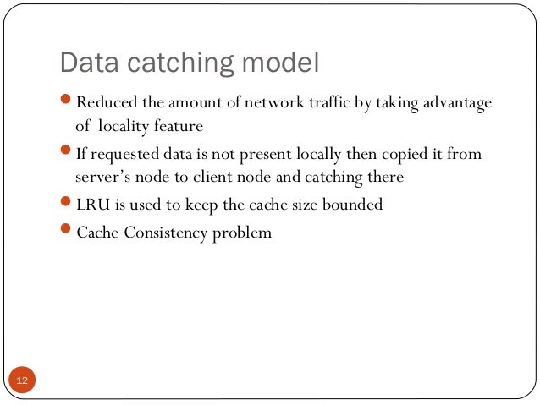

Slide 17
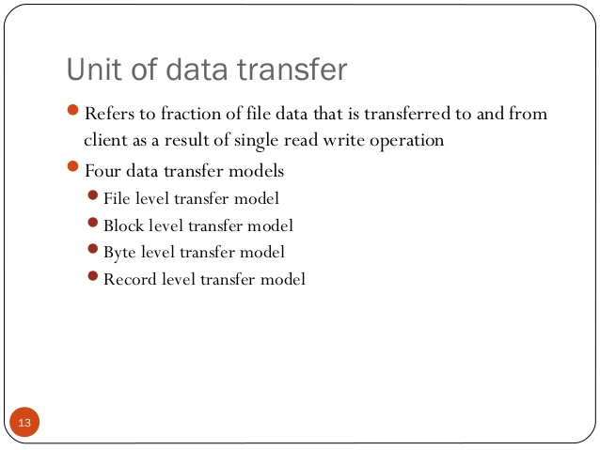

Slide 18
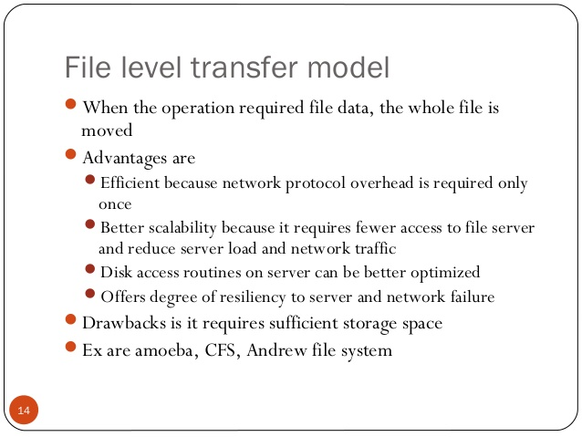

Slide 19
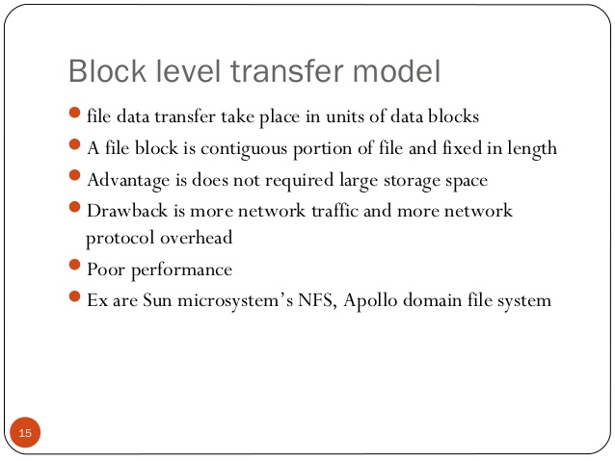

Slide 20
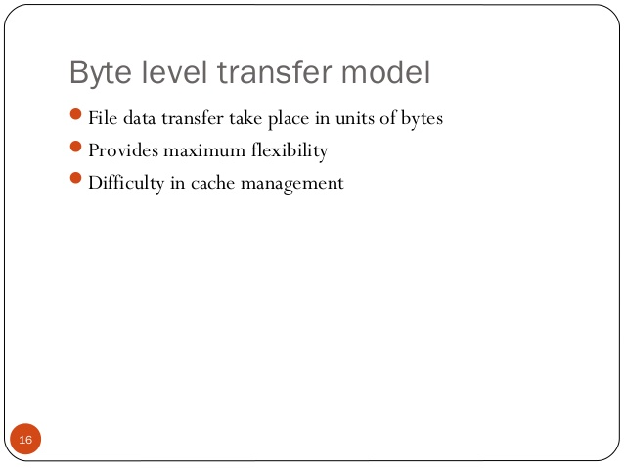

Slide 21
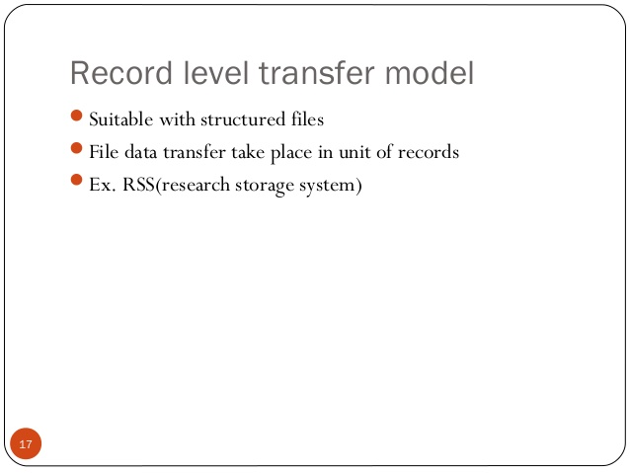

Slide 22
File-caching Scheme
A file-caching scheme for a distributed file system contributes to its scalability and reliability as it is possible to cache remotely located data on a client node. Every distributed file system use some form of file caching.
The following can be used:
1 Cache Location
2 Modification propagation
3 Cache validation schemes

Slide 23
Case study
Distributed File System (DFS)
Network File System (NFS)
Andrew File System (AFS)

